Slide 1

Shortest Path Algorithm with Heaps
ADVANCED DATA STRUCTURE
2022/3/31
Group 17

Slide 2
CONTENTS
Algorithm
Specification
1
Introduction
2
Analysis
and Comments
3
Testing Results
4

Slide 3
Introduction
Chapter 1: problem description and problem solving limitation.

Slide 4

Introduction
Problem
Using Dijkstra's algorithm to solve the shortest road problem. Instead of using array like we used in fds, this implementation shall be based on a min-priority queue. And in the final program, we need to use at least 2 different queue, which must contains Fibonacci heap.
Dijkstra Algorithm
File reading and writing
Priority queue

Slide 5
Algorithm Specification
Chapter 2 : Introduction to data structure and functions used

Slide 6
Algorithm Specification
Language
Heap
Node/Heap
Point
C++
Binary Heap, 2-3-4 Heap, Paring Heap, Leftist Heap, Skew Heap, Fibonacci Heap
class
public
heap->function
Points on the map.

Slide 7
Project framework
.hpp
Function and definition
The definition of all heap nodes and the implementation of functions are in this module.
main
File read and Dij
project
Find the main algorithm of the shortest path and read the data of the first graph.
sample
Data
Real data downloaded on the website.

Slide 8
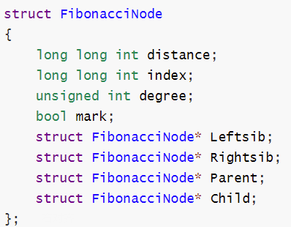
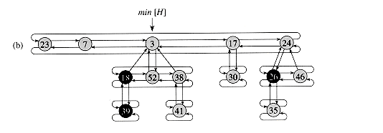
Fibonacci Heap

Slide 9
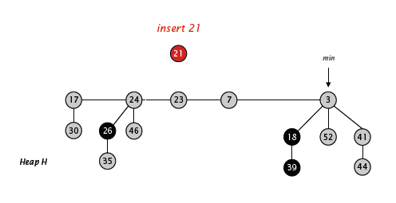
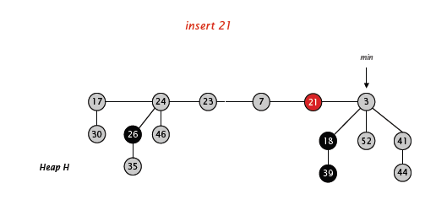
Fibonacci Heap-Insert

Slide 10
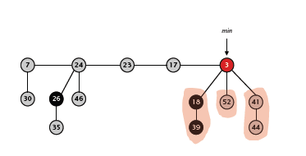
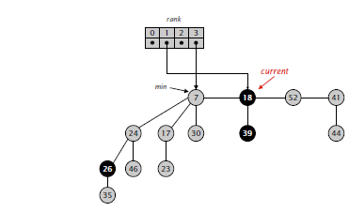
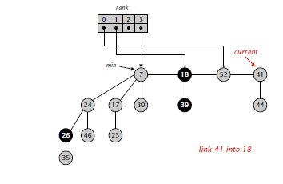
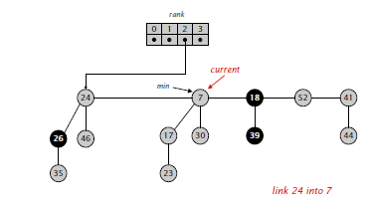
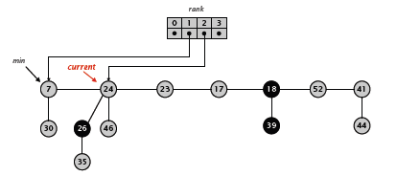
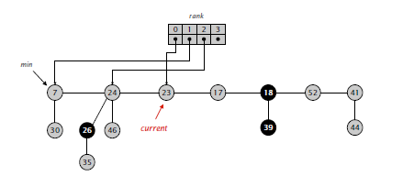
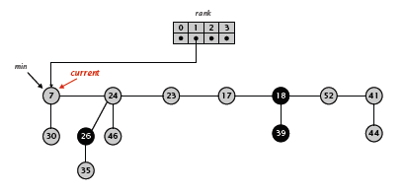
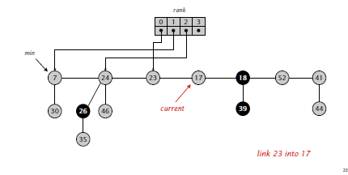
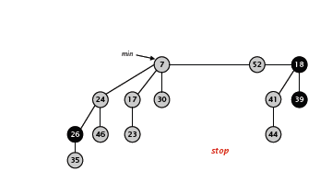
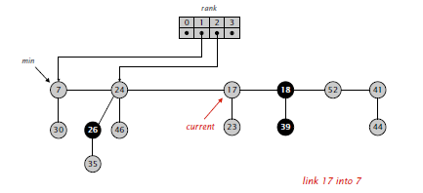
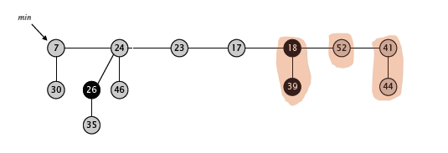
Fibonacci Heap-Delete Min

Slide 11
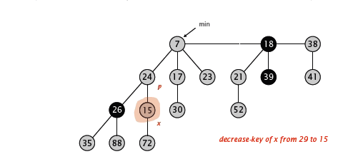
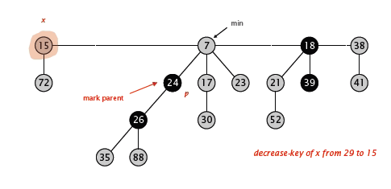
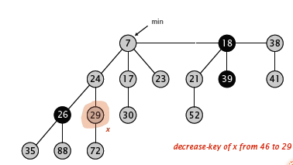
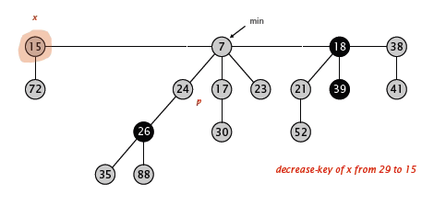
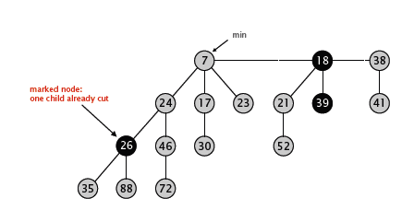
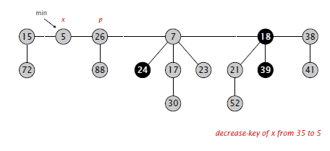
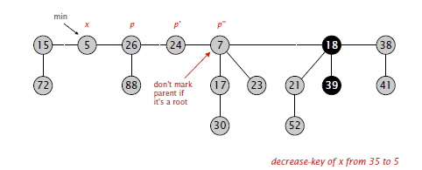
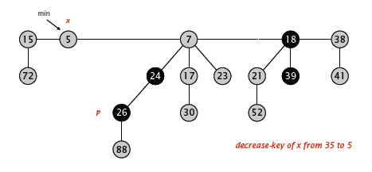
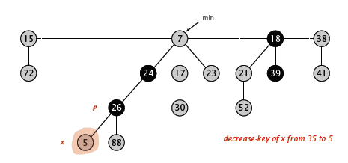
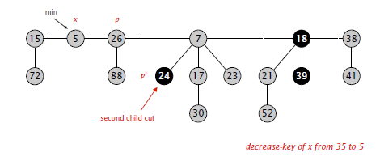
Fibonacci Heap-Decrease Key

Slide 12
Fibonacci Heap-Node Count
The degree of the ith child joining x is at least i-1
After join, the number of child y lost is at most 1, so the degree of y >= i-2.
The number of nodes of a Fibonacci Heap with degree of K is at least Sk-1 + Sk
S0 = 1;
S1 = 2;
S2 >= S0 + S1
S3 >= S1 + S2
…………
Exponential growth

Slide 13
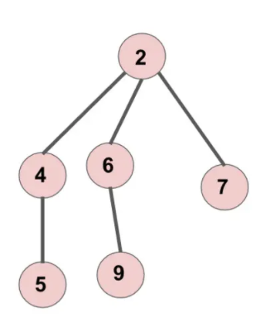
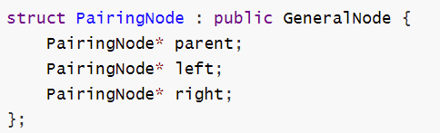
Paring Heap-Node
A pairing heap is either an empty heap or a pairing tree, which is composed of a root element and a list of pairing trees that may be empty.
The ordered attribute of the heap makes the root element of all subtrees in the list no less than the root element of the heap.

Slide 14
Paring Heap-Merge
case 1 :Merging an empty heap returns another heap
case 2 :Link the 2 heaps
6
3
3
7
6
7
6
6
7
9
7
9

Slide 15
Paring Heap-Insert
insert
5
3
6
8
7
5
7
9

Slide 16
Paring Heap-Insert
2
insert
2
3
6
8
7
7
9

Slide 17
Paring Heap-Decrease Key
3
1
6
8
7
7
9
if the node is the root , decrease directly.

Slide 18
Paring Heap-Decrease Key
3
6
8
7
8
2
7
9
10
if the node is the root , decrease directly.

Slide 19
Paring Heap-Decrease Key
2
3
2
3
10
10
6
8
7
6
8
7
7
9
7
9
if the node is the root , decrease directly.

Slide 20
Paring Heap-Delete Min
3
6
8
7
8
7
9
10
if the node is the root , decrease directly.

Slide 21
Paring Heap-Delete Min
6
8
7
8
7
9
10
if the node is the root , decrease directly.

Slide 22
Paring Heap-Delete Min
6
8
8
7
7
8
7
8
9
9
10
10
if the node is the root , decrease directly.

Slide 23
Testing Results

Slide 24
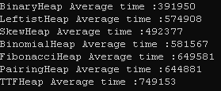

Slide 25
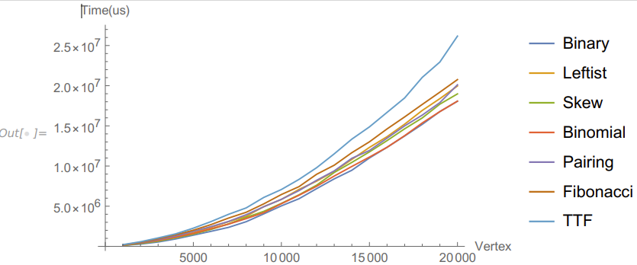

Slide 26
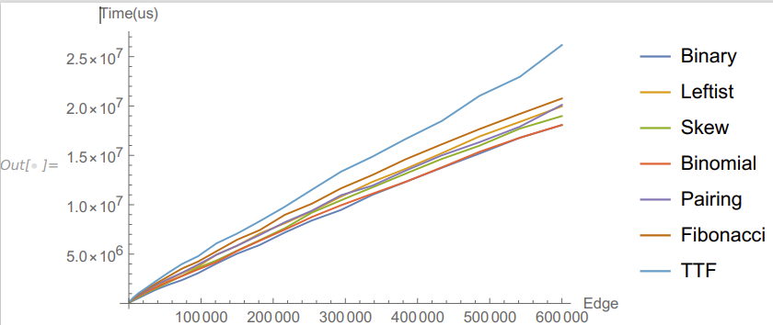

Slide 27
Analysis
and Comments

Slide 28
Analysis and Comments
Heap Name | Binary | Binomial | 2-3-4 | Skew | Leftist | Fibonacci | Paring
Insert | O(logN) | O(1)amortized | O(1) | O(logN) | O(logN) | O(1) | O(1)
DeletMin | O(logN) | O(logN) | O(1) | O(logN) | O(logN) | O(1) | O(1)
DecreaseKey | O(logN) | O(logN) | O(N)(??) | O(logN) | O(logN) | O(logN) | O(logN)
Dijkstra | elogv | (v +e)lgv |  | (v +e)lgv | (v +e)lgv | vlgv + e | (v +e)lgv

Slide 29
THANKS
Thank you for the criticism of the experts
2022/3/31
Group 17

